Slide 1
ZOOM.
SANSKAR SINGH
FYIT
ROLL NO: 86

Slide 2
POINTS OF REFRENCES:
INTRODUCTION
HISTORY
WORKING
FEATURES
USAGE

Slide 3

Introduction:
Zoom Meetings (commonly shortened to Zoom, and stylized as zoom) is a proprietary video teleconferencing software program developed by ZOOM VIDEO COMMUNICATIONS. The free plan allows up to 100 concurrent participants, with a 40-minute time restriction. Users have the option to upgrade by subscribing to a paid plan. The highest plan supports up to 1,000 concurrent participants for meetings lasting up to 30 hours.

Slide 4
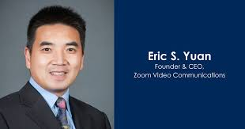
history:
Zoom was originally founded in 2011. Its headquarters are located in San Jose, California. Zoom also has offices in Europe, Asia, and Australia. A beta version of Zoom—that could host conferences with only up to 15 video participants—was launched on August 21, 2012. On January 25, 2013, version 1.0 of the program was released with an increase in the number of participants per conference to 25

Slide 5
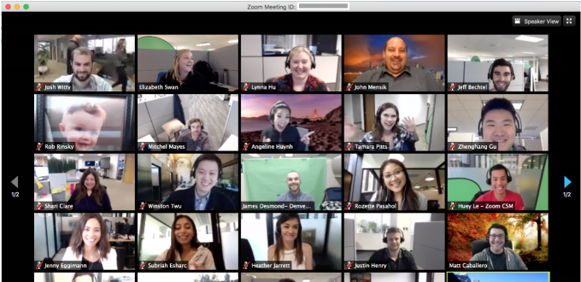
Working:
Zoom allows one-to-one chat sessions that can grow into group calls, training sessions and webinars for internal and external audiences, and global video meetings with up to 1,000 participants and as many as 49 on-screen videos. The free tier allows unlimited one-on-one meetings but limits group sessions to 40 minutes and 100 participants. Paid plans start at $15 per month per host.

Slide 6
features:
One-on-one meetings: Host unlimited one-on-one meetings even with the free plan.
Group video conferences: Host up to 500 participants (if you purchase the "large meeting" add-on). The free plan, however, allows you to host video conferences of up to 40 minutes and up to 100 participants.
Screen sharing: Meet one-on-one or with large groups and share your screen with them so they can see what you see.
Recording: You can record your meetings or events too.

Slide 7
Usage:
Since the start of the COVID-19 pandemic, Zoom has been used by banks, schools, universities, and government agencies around the world by the UK Parliament by healthcare professionals for telemedicine, barbershops, and ceremonies such as birthday parties, funeral services, and bar and bat mitzvah services. Zoom formed a partnership with formula one to create a virtual club where fans can go behind the scenes and take part in virtual activities through Zoom, beginning with the Hungarian Grand Prix on July 19, 2020. An article published in July 2020 in the San Francisco Chronicle noted a new real estate trend in San Francisco and Oakland where some listings include "Zoom rooms" with backdrops for Zoom calls.

Slide 8
Thank you…

